Slide 1
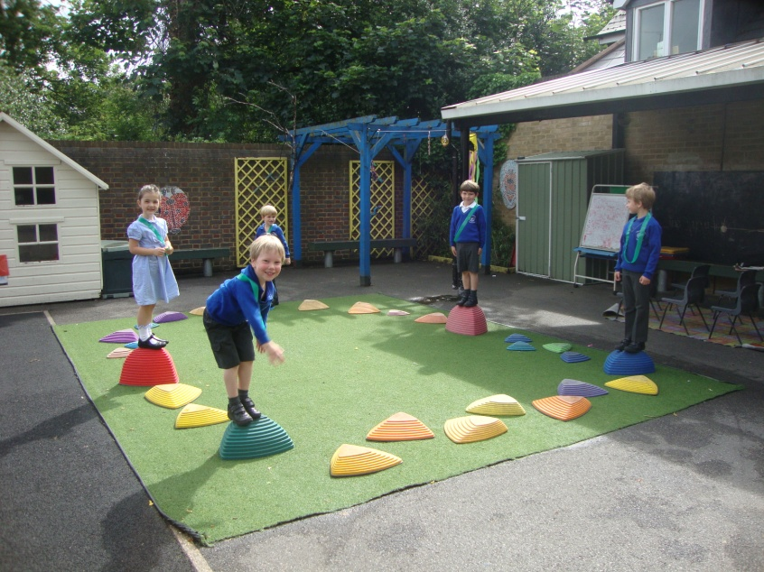
Welcome to St Mary’s C of E Primary School
The Early Years Foundation Stage
http://st-marys.richmond.sch.uk/our-school-film/

Slide 2
Welcome!
We thank you for choosing us and are delighted to welcome you to St Mary’s. We value the trust you place in us to educate your child.

Slide 3
EYFS Curriculum
There are seven areas of learning
Three prime areas
Communication and language
Physical development
Personal, social and emotional development
Four specific areas
Literacy
Mathematics
Understanding the world
Expressive arts and design
Notes:
The first 3 areas are the prime areas which are “crucial for igniting children’s curiosity and enthusiasm for learning, and for building their capacity to learn, form relationships and thrive.”
EYFS is thoroughly planned play – the chn’s learning is their play & their play is their learning . We use both of these words so the chn appreciate that they are always learning e.g. Can you come & do some learning in the sand or let’s play with the letters and see what words we can make.
* Free flow – bands for outside, areas of learning same outside/inside

Slide 4
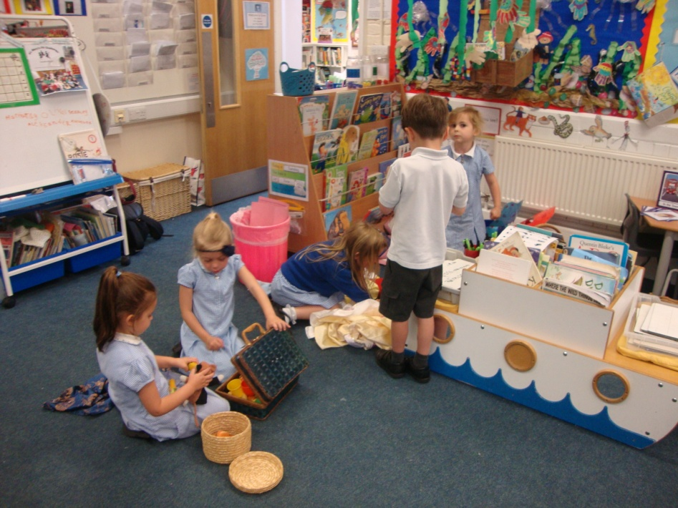
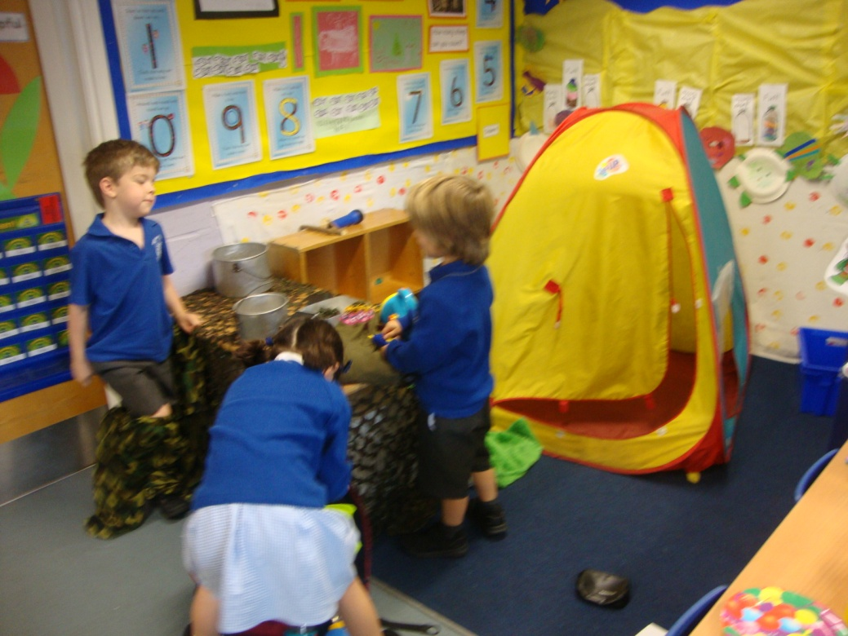
Communication and Language
Talk, talk, talk!

Slide 5
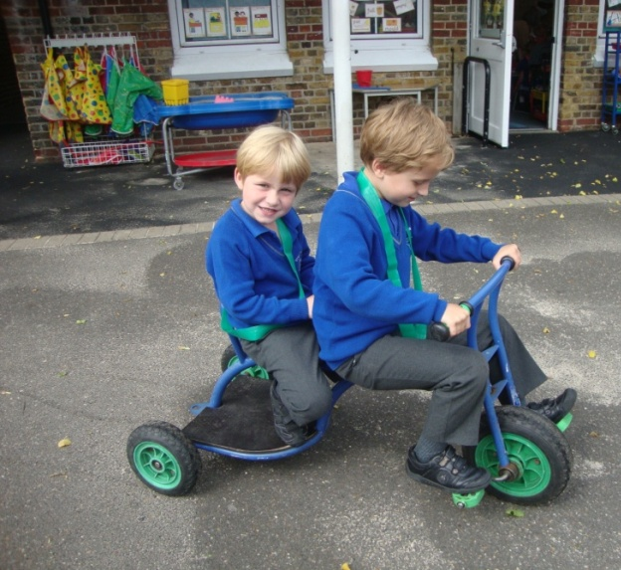
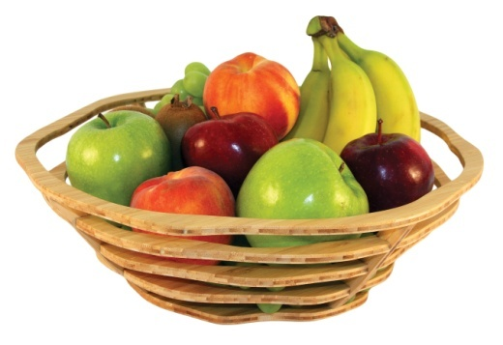
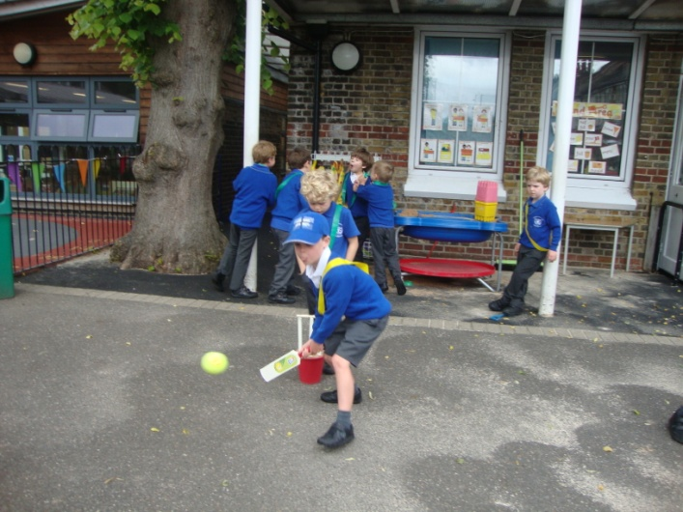
Physical Development
Buttons, zips, pencil grip!
Notes:
.

Slide 6
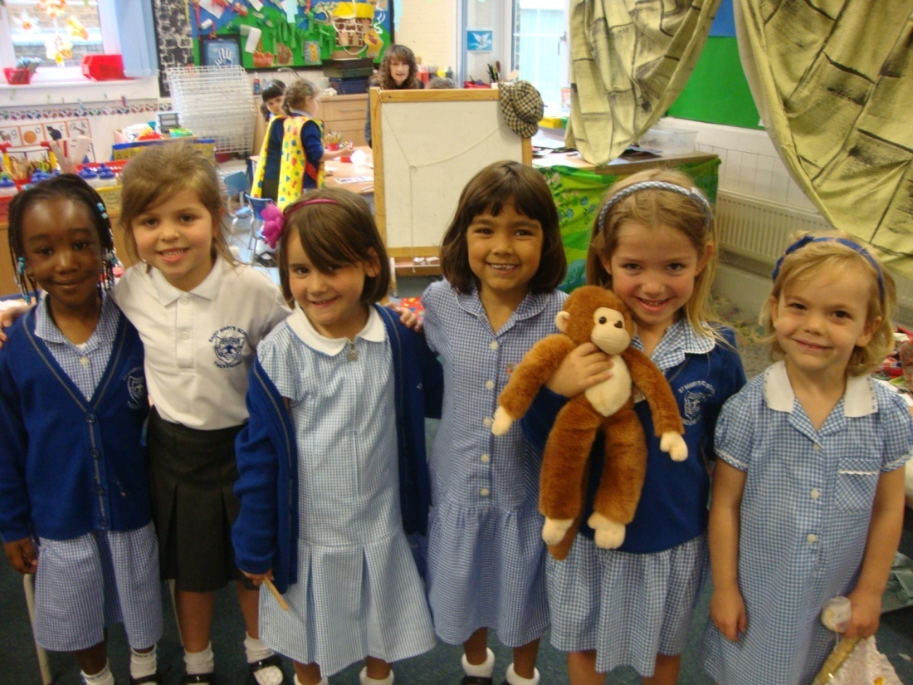
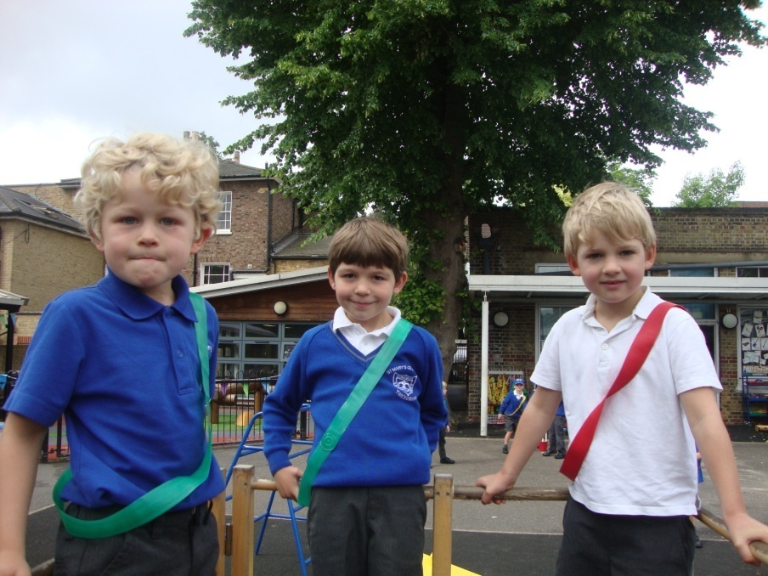
Personal, Social and Emotional Development
Play dates, building resilience!

Slide 7
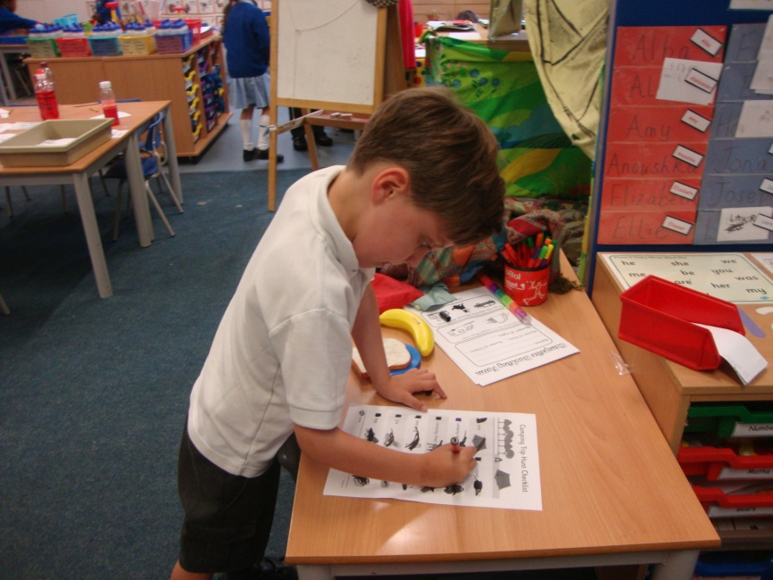
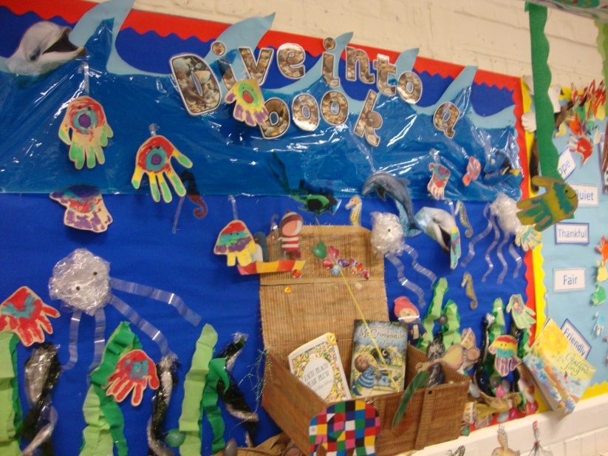
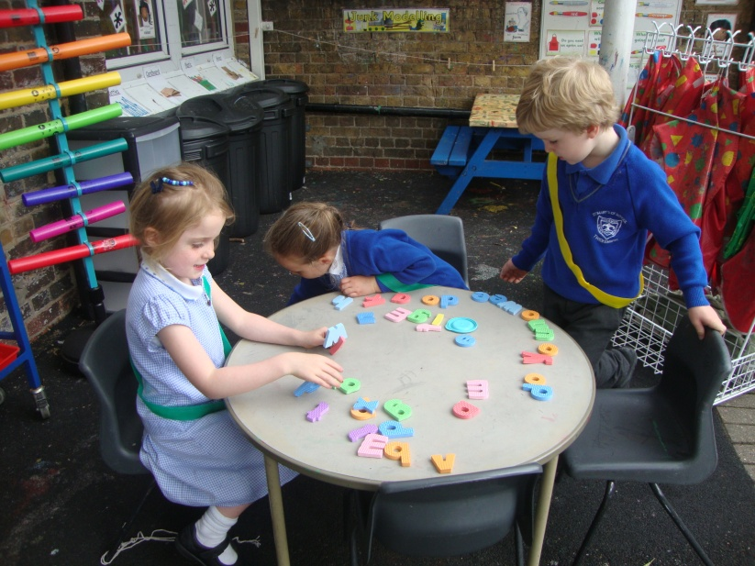
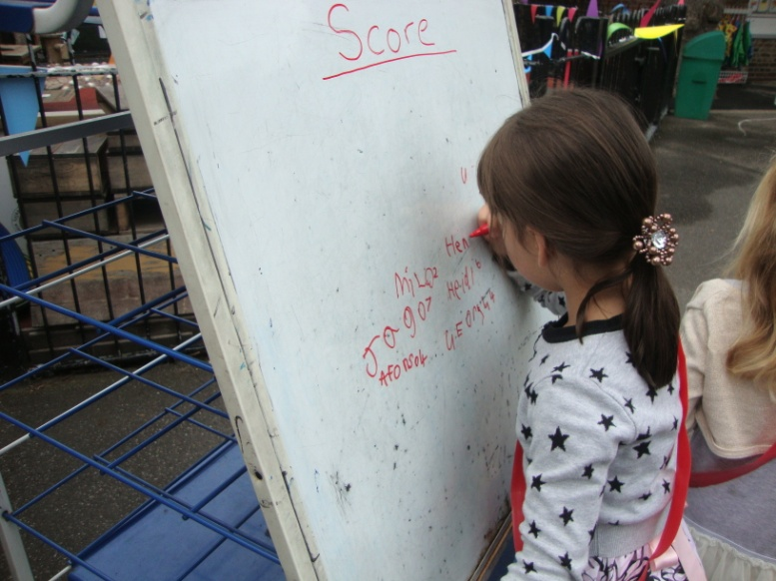
Literacy
Cursive script and lower case letters!

Slide 8
Cursive Script

Slide 9
Phonics and reading
Suggested reading for the summer:
Room on the broom, The snail and the whale, The smartest Giant, Dear Zoo
Farmyard Hullabaloo, Rumble in the Jungle, The Tiger who came to Tea
Percy the Park keeper stories
Phonics play - www.phonicsplay.co.uk
Busy things
Education city
Twinkl also has lots of handwriting and pencil control sheets

Slide 10
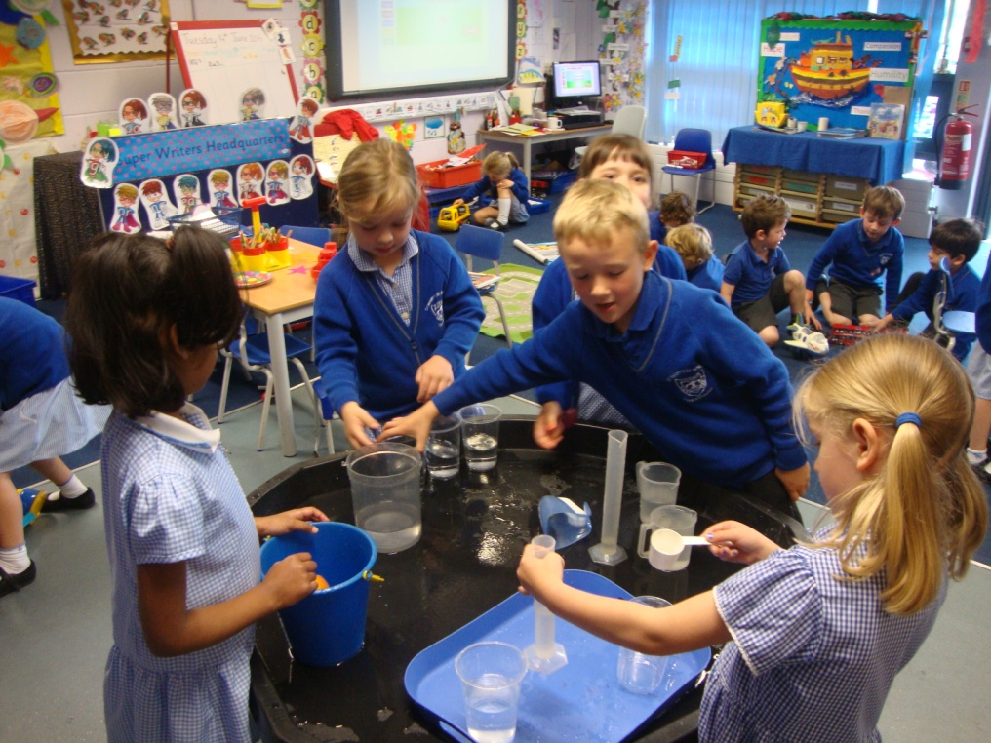
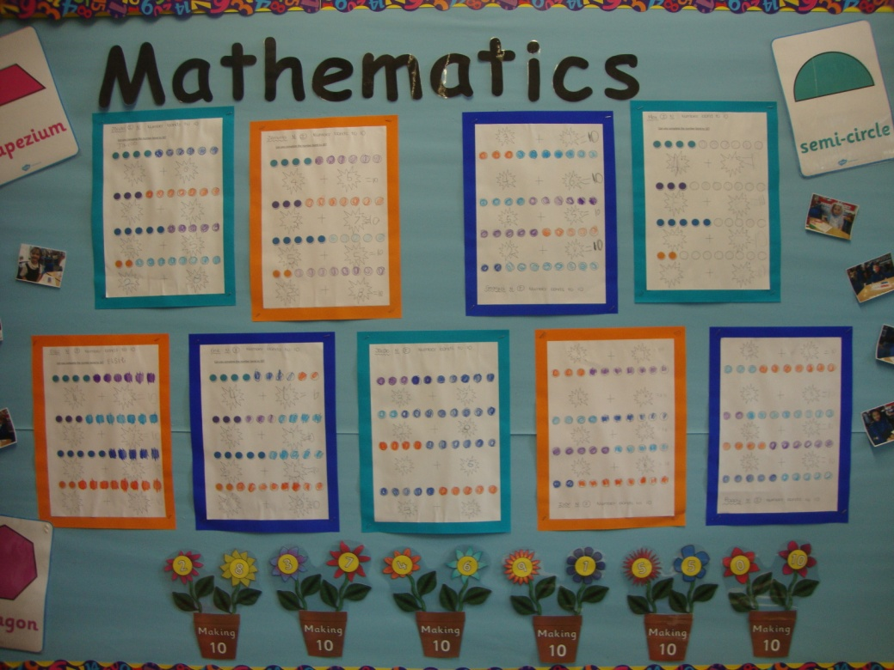
Mathematics
Numbers , patterns and counting around our environment

Slide 11
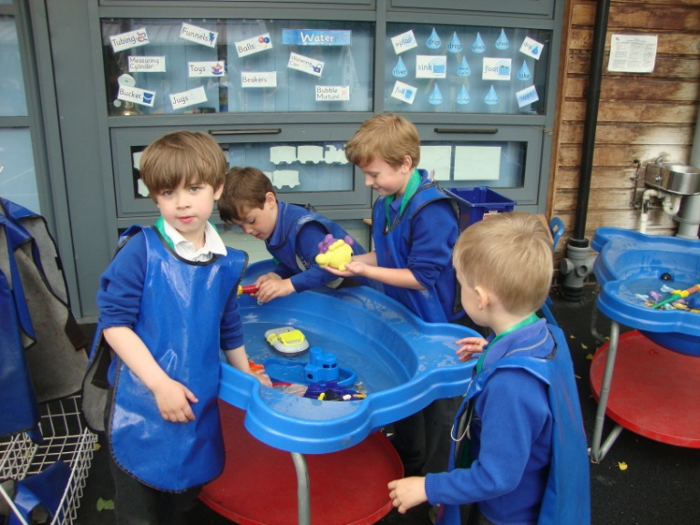
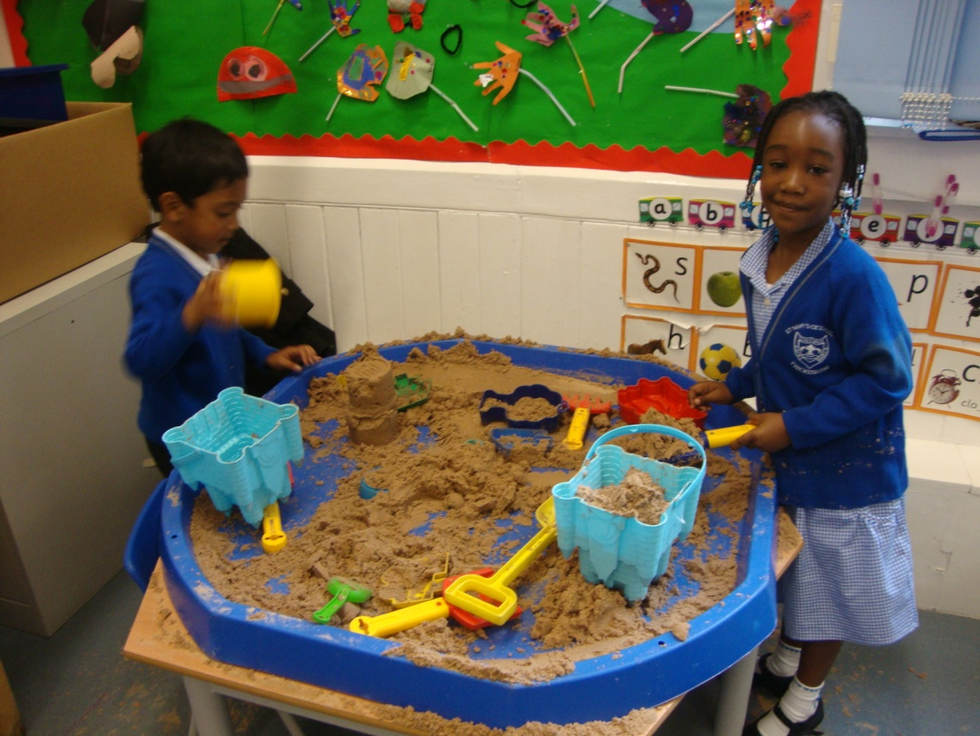
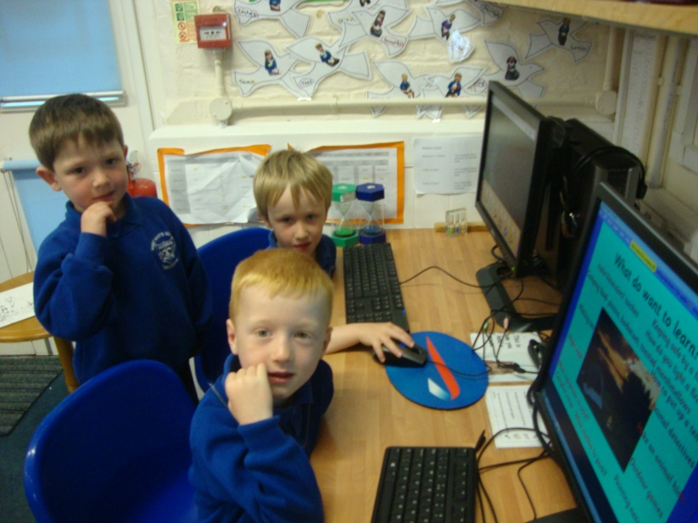
Understanding the World
Floating, sinking, digging, questioning

Slide 12
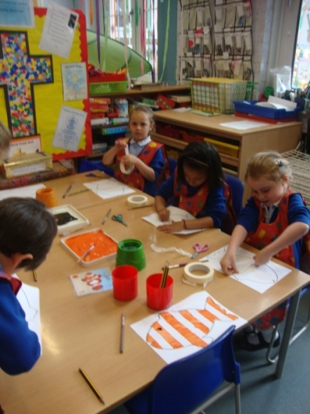
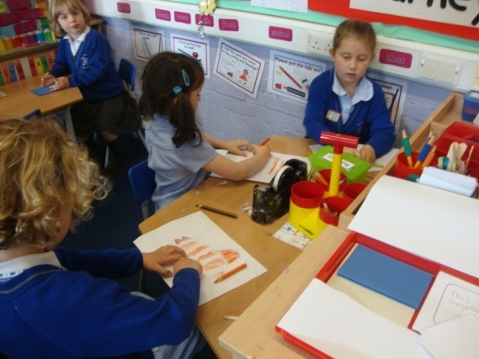
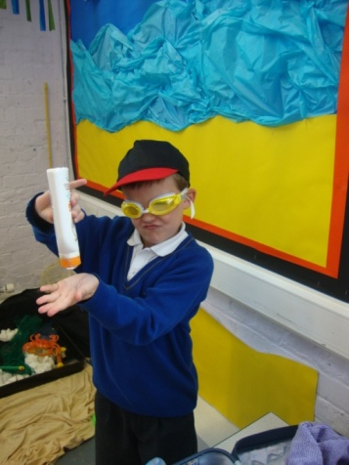
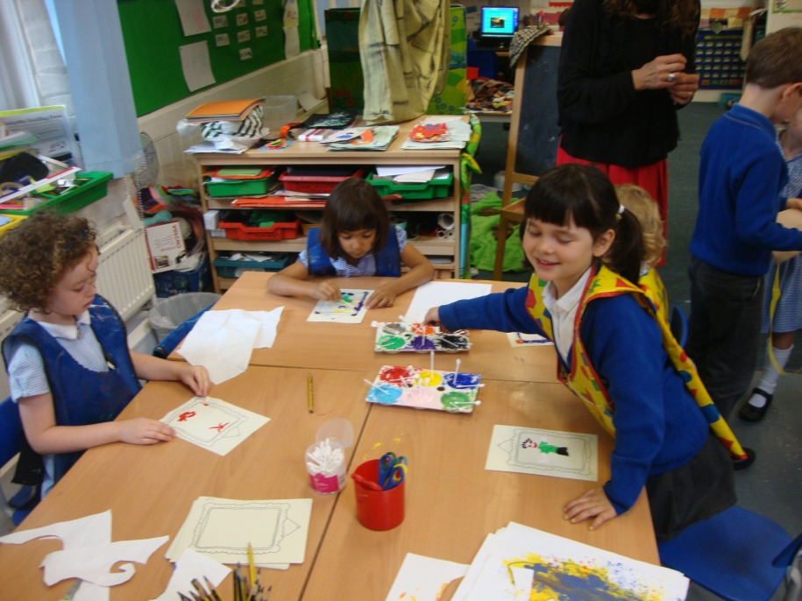
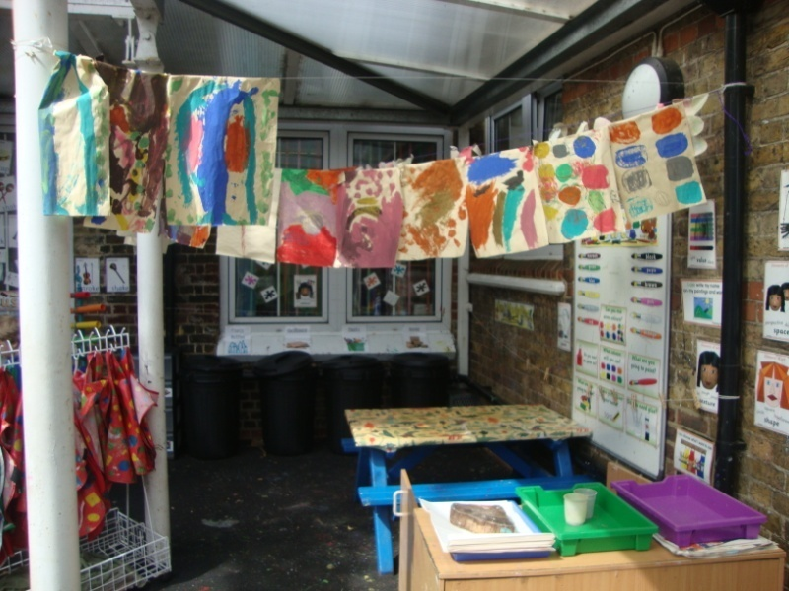
Expressive Arts and Design
Junk isn’t junk it’s a ship, a building, a work of art!
Notes:
.

Slide 13
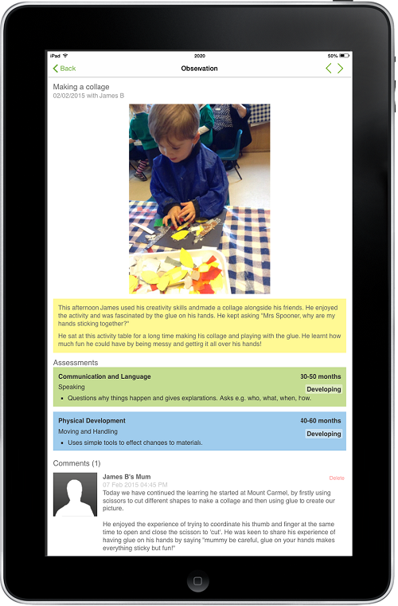
We use an online learning journal called Tapestry. By logging on with a secure username and password you will be able to view and comment on all of your child’s observations, photographs and even videos from their time in Reception.

Slide 14
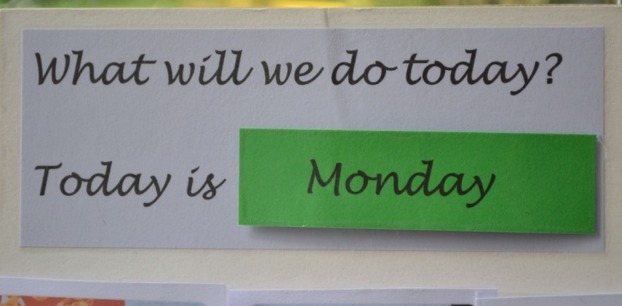
An Integrated Day...
Register and carpet time
Collective Worship
Teaching sessions run throughout the day with children initiating their own learning between sessions with their teacher
The classroom extends to outside and reflects all that is going on inside
Fruit time and water- children are taught to serve themselves
Lunch time
Home time

Slide 15
Communication
Home visits
Day to day conversations at pick up and drop off
Half termly letter
Parent consultations throughout the year
School Communicator
Newsletters
Weekly Parent Mail
Website
Twitter
Tapestry

Slide 16
Drop in sessions
A time to come into school with your child to explore the classroom environment, meet your teacher and make some new friends.
27th June
28th June
3.15pm- 3.45pm

Slide 17
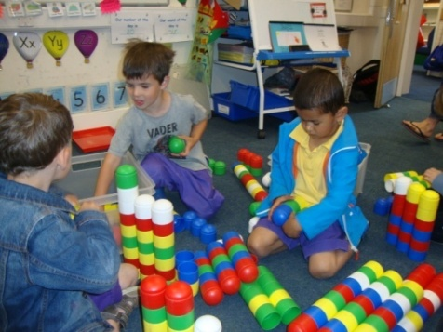
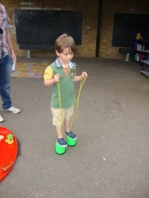
Move up morning
Monday 2nd July ( Arragon Road gate)
10-11am
It’s an opportunity for the children to explore the new environment and play alongside other children.
Children will come into class by themselves.
Parents to meet each other and members of FOSm in the hall with tea and coffee.

Slide 18
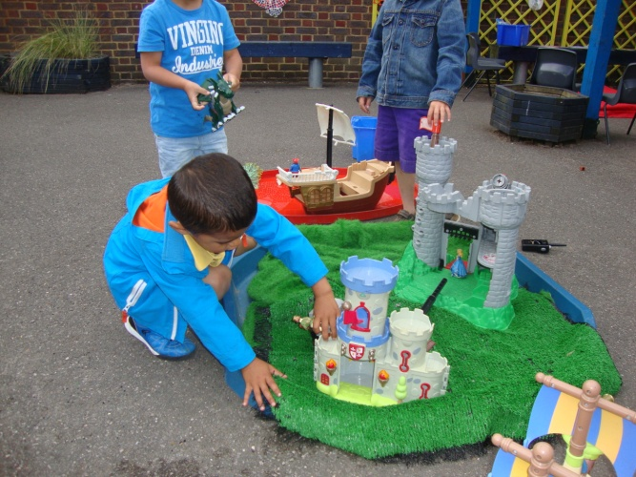
Home Visits
10th, 12th and 13th July
15 minutes visit by the class teacher and the teaching assistant or other key member of staff
An opportunity for us to start to build a relationship with you and your child and to get to know a bit more about your child in their home environment

Slide 19
The School Day
Reception start at 9am on the first day and children come in, in small groups. For a short period they will only stay half a day.
Thereafter the children start 8.30am and go home at 3pm.
All classes will enter through the Arragon Road gate and will wait by their classroom door. Doves classroom will be accessed by the door opposite our Arragon Road gate and Blackbird and Robins classrooms will be accessed by their doors on the Reception playground.

Slide 20
In your pack you will find additional information about St Mary’s
Please complete all the forms and return them to the office
Please check the details, especially the address, are correct
All of our policies are on the school website
Notes:
.

Slide 21
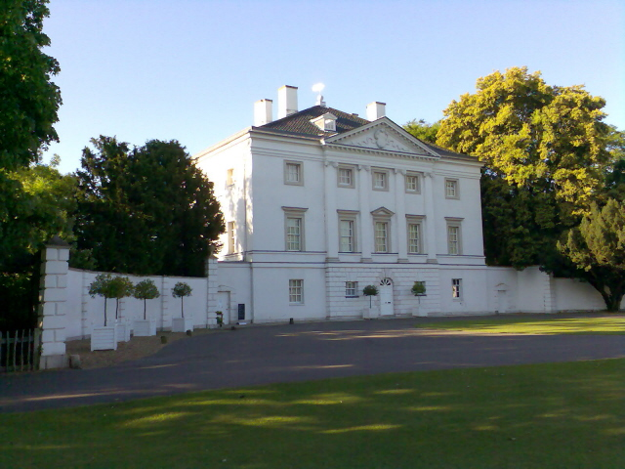
How to meet other parents and children?
Meet up at an informal picnic organised by a few parents:
Sunday 9th Sept
11.30am
Marble Hill Park
( fenced in play area)
Reception Whatsapp group
Speak to Emma Fallows, Mum of child in Robins
Class on 07803 906599

