Slide 1
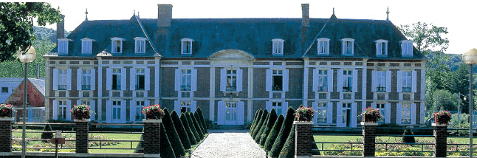
Year 6 School Journey to France
10th-14th June 2018

Slide 2
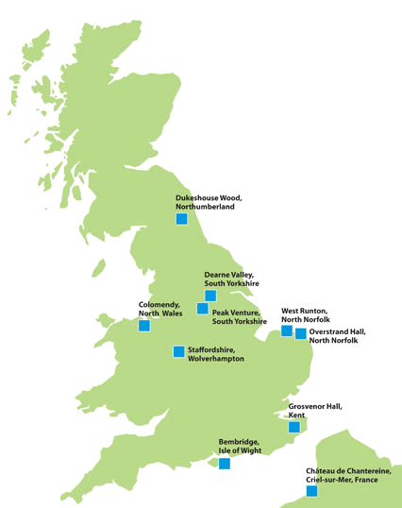
Criel-sur-Mer is an old fishing village located on the Upper Normandy coast.

Slide 3
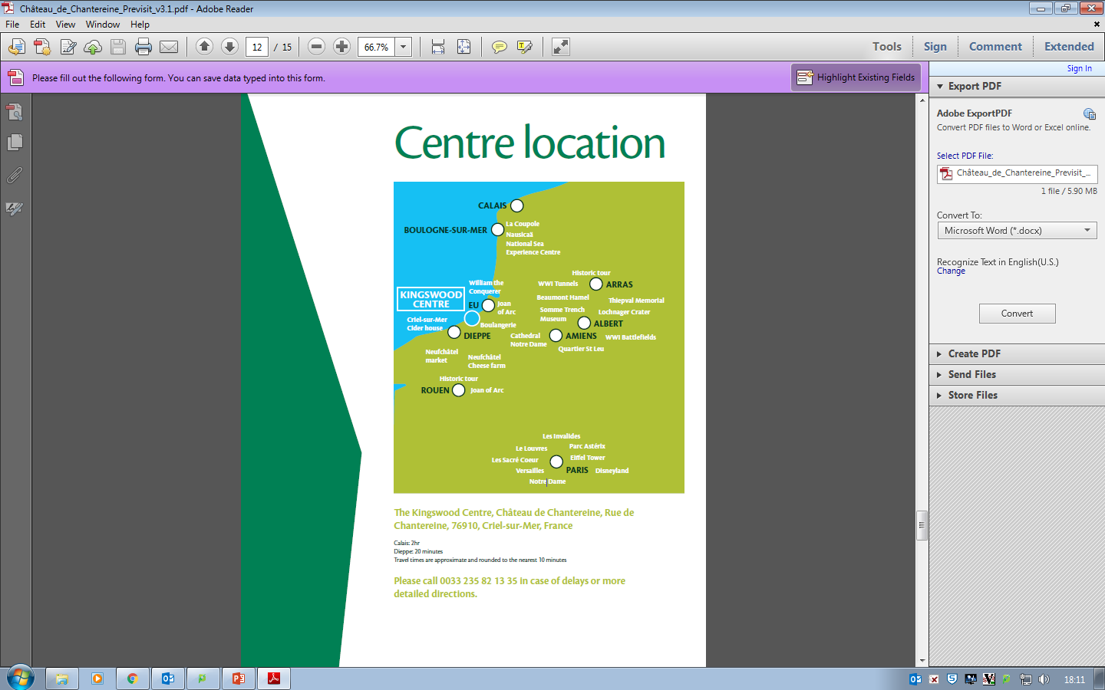

Slide 4
Itinerary
Monday’s journey to France:
Depart by coach at 8am (2.5 hours to Folkestone)
Take Eurotunnel (11am train)
30 mins drive to Nausicaa Aquarium in Boulogne
1.5 hours to Criel-sur-Mer
Arrive at the Chateau around 6pm
Friday’s return to UK:
Visit Eu market
Return by 5pm

Slide 5
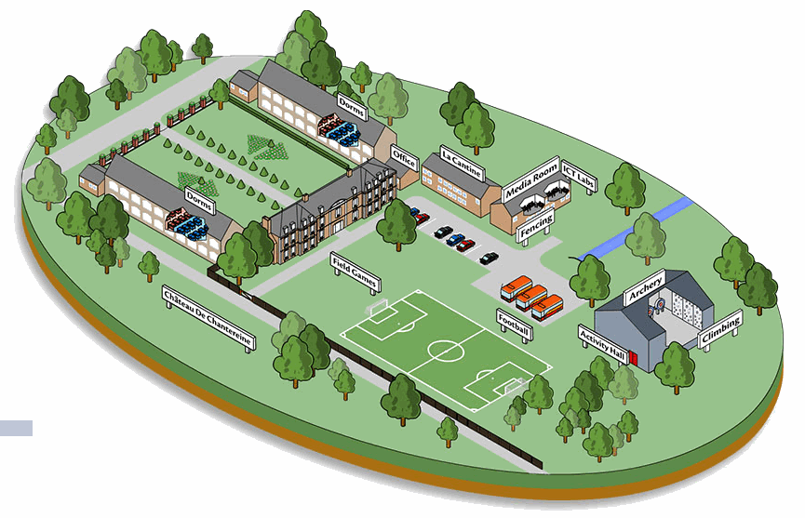
Chateau de Chantereine
A beautiful, fun-filled, safe location for the children to thrive.

Slide 6
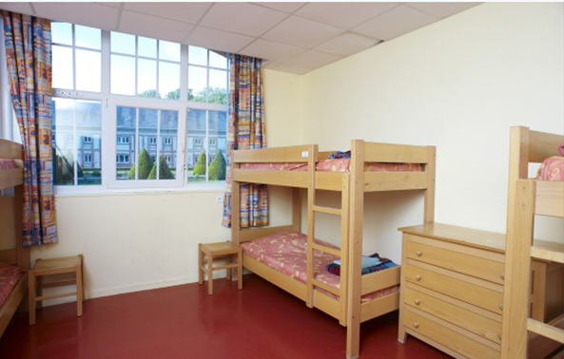
Dormitories
- The centre has secure and clearly defined borders with perimeter fencing and CCTV.
- Fire safety briefing on arrival, followed by emergency fire drill.
- Teachers located at end of dormitory corridors; monitoring system; Duty Manager available through the night.
- Fully-qualified First Aid staff on site at all times, in addition to our own First Aiders.

Slide 7
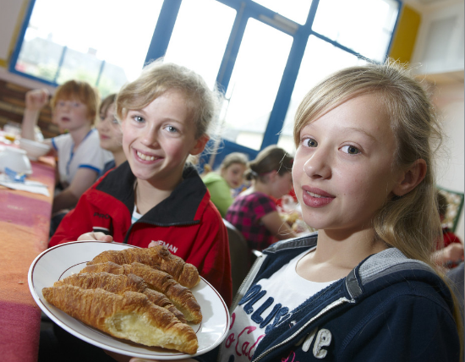
Food
Breakfast is a continental buffet with brioche, baguettes, cereals, tea, coffee, milk and juice with croissants on the last morning
Lunch is a make-it-yourself packed lunch with a variety of ingredients on a buffet to choose from: hams, cheeses, tuna, salad, tomatoes, cucumber… as well as a juice box, a bottle of water, fruit, a packet of crisps and biscuits
All dietary requirements and all allergies can easily be accommodated.

Slide 8
Itinerary
Activities throughout the week:
Guided tour of Rouen the capital of Normandy.
Visit a cheese farm.
Tour of Dieppe including visit to creperie
French battlefields
Walk to local beach
Visit to local market
Archery, climbing, fencing

Slide 9
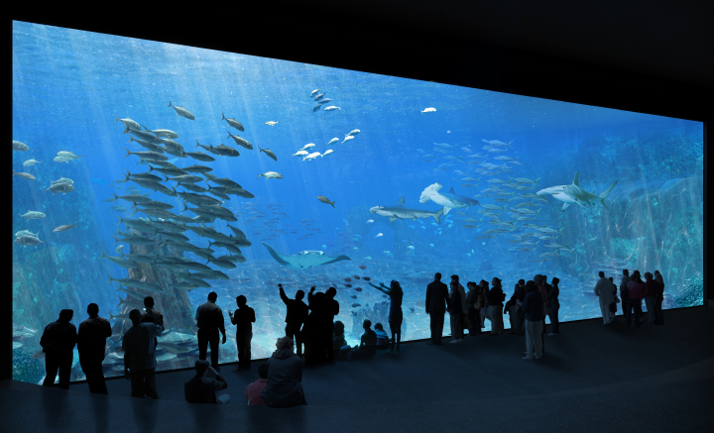

Slide 10
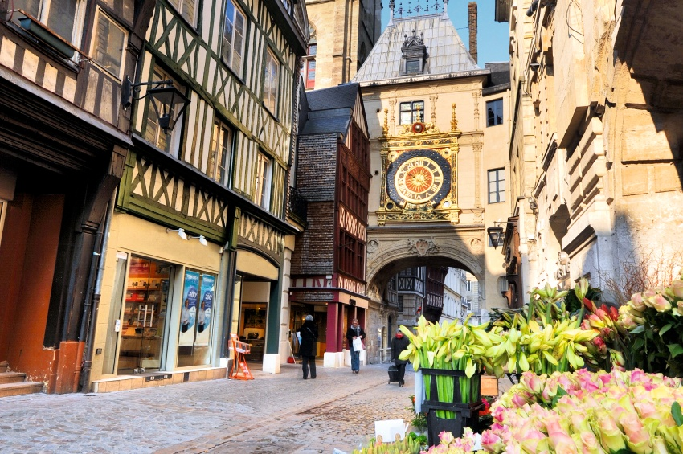

Slide 11
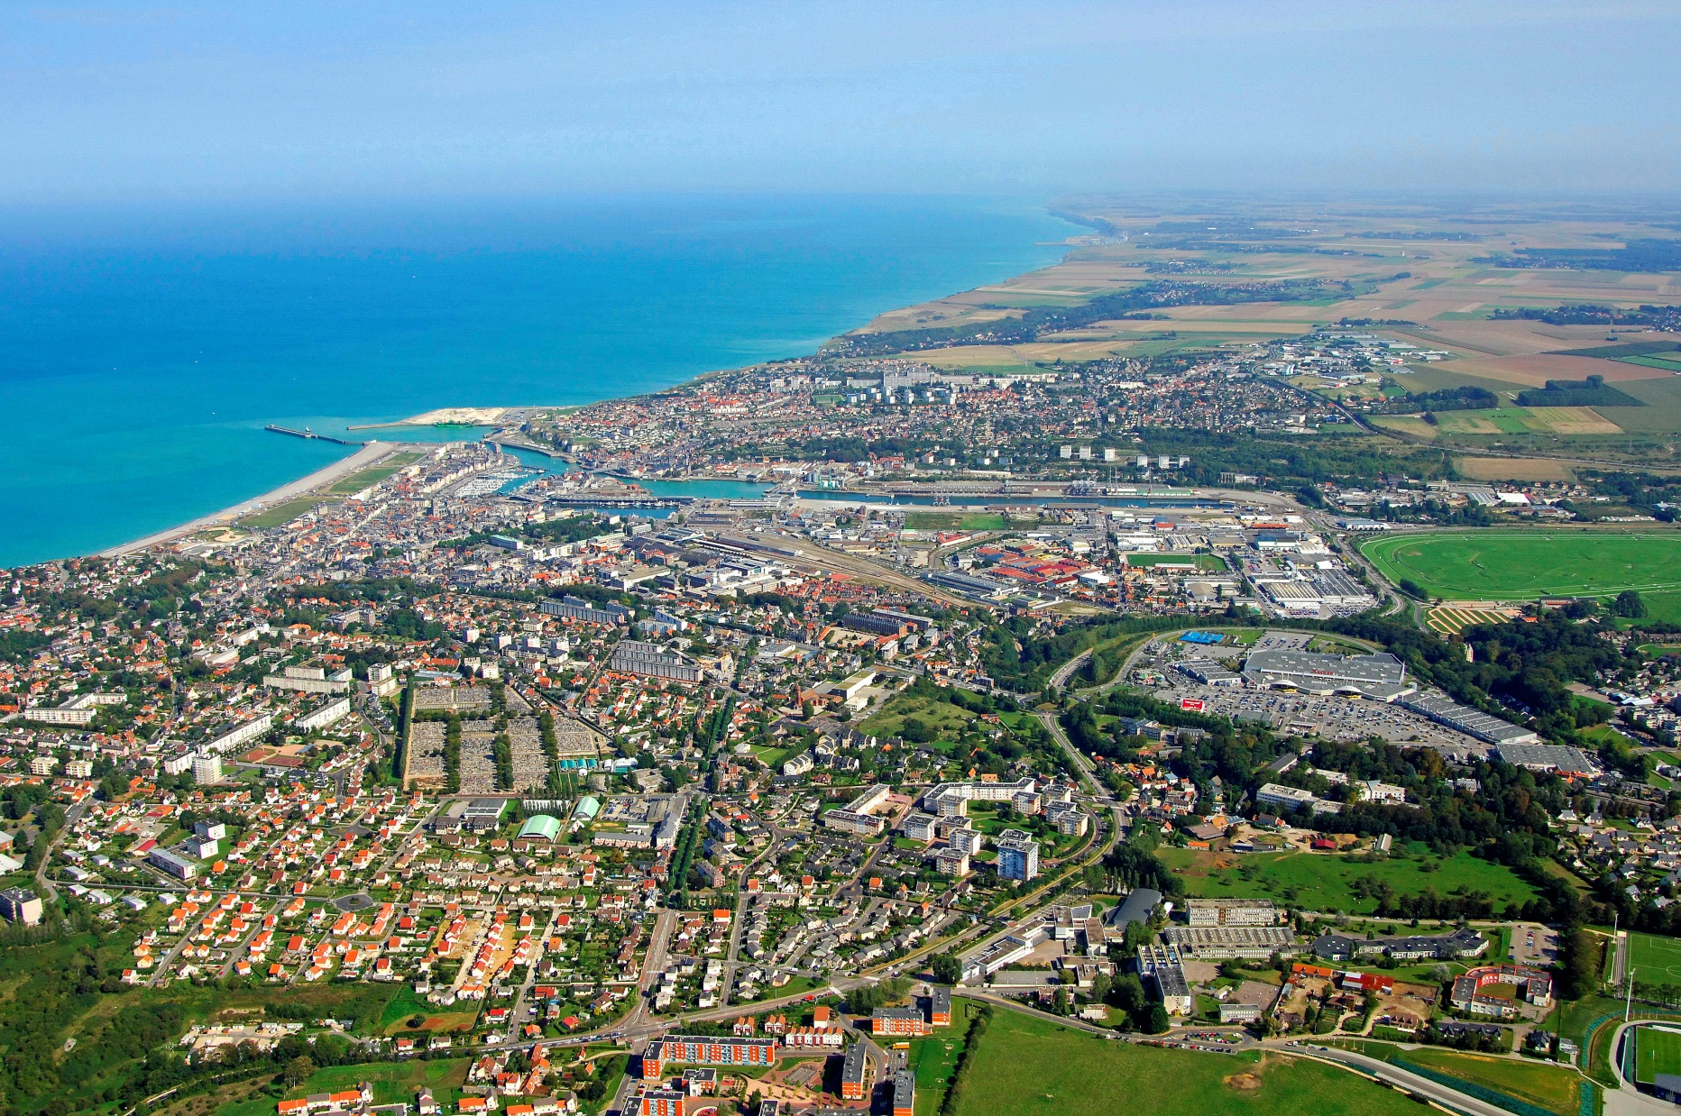

Slide 12
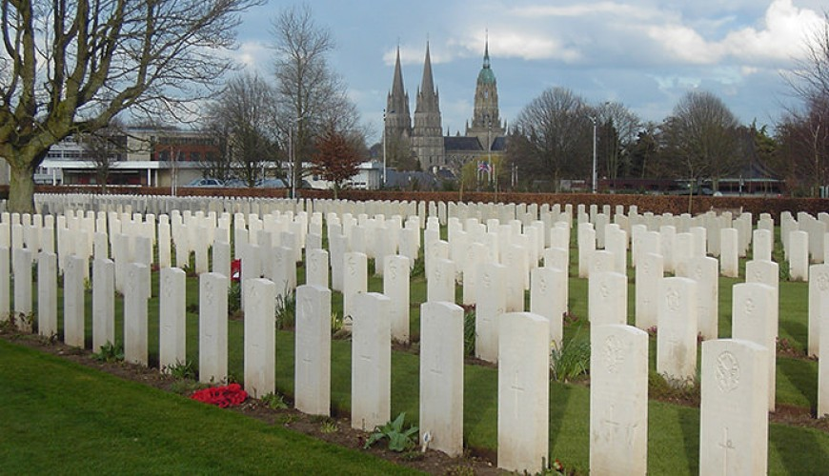

Slide 14
Daily Routines
Wake up at 7.30am
Breakfast at 8am
Morning activities
Lunch (on the go)
Afternoon activities
Before dinner games (French games, Team Tech, Field Games)
Dinner 7.30pm
Evening activities (Mini-Olympics, fencing, disco)
- Bed time 9.30pm

Slide 15
Forms/Admin - You will receive a 'pack' closer to the time containing: - Hayfever form - Capol - waiver - Travel Sickness form - General medication form - Permission form Kit list Payments: suggested installments of £99.50 in November, January, February, March. - Passports will be collected in after 'pack' goes out. - Please let us know ASAP if your child is travelling on a non E.U passport.

Slide 16
Preparation Kit list (we will send this to you nearer the time) French practice Building up to departure No mobile phone or electronics permitted (with the exception of digital or disposable cameras at own risk of each child)
Blog
Each day we will keep you updated on our adventures on our blog.

Slide 17
https://www.kingswood.co.uk/activity-centres/chateau-de-chantereine/

