Slide 1
Parent Presentation
Supporting Children’s Friendship and Social Communication
Thursday 31st January, 2018
Josephine Burke
Art Psychotherapist
Mental Health Clinician

Slide 2
Expectations
What are friendships
Difference to peer groups
Developmental stages of friendship
Stages of play
Co-operation and attachment
Encouraging friendships
Conflict
Communication
Boundary setting

Slide 3
What are peer groups?
Small group
Interact regularly
Hang out
Do activities
Often share similar attributes & characteristics
Talk to each other
Tend to influence each other over time

Slide 4
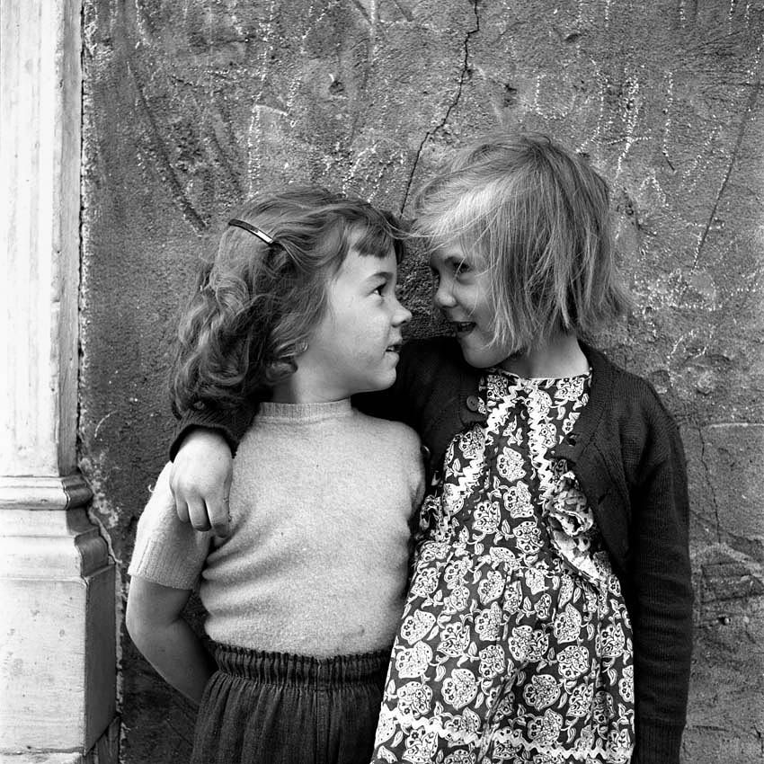
What are friendships?
Dyadic in nature
Reciprocal and mutual Relationship
Sense of equality
Both affirming it with a strong affective tie
Supportive.
Give and take
Voluntary
Different to peer relationships or being socially skilled
Notes:
listen to you when you need to talk
help you if they can
include you in what they're doing
compliment you and make you feel good
respect you, your religion, culture and sexuality.
What they are not:
Put you down
Make fun of you, your religion, sexuality or culture
Put you in danger or make you feel unsafe.

Slide 5
Friendships with changing development
Under 5s
Fun and reliable play mates
Based on who see often
Intimacy and shared understanding through pretend play
5-11
Helping, loyalty and commitment
Fun and affection
Seek different companionship from different ones
12-18
Self disclosure, confiding and intimate
More sophisticated and committed
Emotionally supportive

Slide 6
Stages of Play
Solo play
All ages choose this, younger ones not able for more, child is absorbed in own game and is not interested in or aware of others around them. Children often use solo play as respite from too much social interaction.
Onlooker play
Children may actively observe play without being part of it. Picture a child watching two other kids building a tower. They might add a comment or two to shape the play but won’t actually join in. This is more typical with younger children or kids needing to build up their trust first (either by learning about the activity or the people involved in it). Being an observer is a safe role. Some children need lots of it.
Parallel Play
Playing side by side. Two-year-olds are great at this. Picture toddlers playing near each other in the sandbox or two kids playing with trains at the same time but not building the track together. Children in this stage are absorbed in their own game and concerned about safety. Will I be safe? Will the other child interfere? Child is aware of the other child and may imitate what they are doing. This is considered the first stage of group play.
Group play (associative and co-operative)
Starting about age 4, children begin to make first friends and advance to complex social play. This group play is often split into associative and co-operative. Associative lacks a true common goal but shares many elements. Cooperative play is often dramatic, pretend play. “Lets play house. I’ll be the Daddy”, or “sharks! Get away! Come onto my boat fast!” Games like tag or hide and seek are co-operative play, as well as joint projects such as building a tall tower out of blocks together.
Mixed stages of play
Children move between stages of play. There’s nothing unusual about a five year old who wants to play by himself, or a four year old who wants to observe for a long time before participating. Kids who are old enough to engage in cooperative play may enjoy being in a group of kids or may prefer the company of a single ‘best friend’.

Slide 7
Promoting cooperation and good attachment
Play and attention
Communication
Praise and encouragement
Emotion coaching
Empathy
Persistence coaching
Notes:
JS

Slide 8
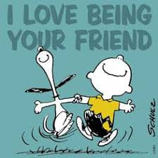
Encourage friendships
Modelling
Providing opportunities
Empathy
Not taking sides
Problem solving
Slow down
Communicate
Reflect on own attachments

Slide 9
Conflict
Threat of play (changing, stopping, abandonnment)
Help to identify and communicate feelings (‘I feel…)
Help define the problem
Problem solve
Direct communication/confrontation to the right person
Bring kids together - listen and encourage listening
Reinforce communication
Get commitment
Put into action

Slide 10
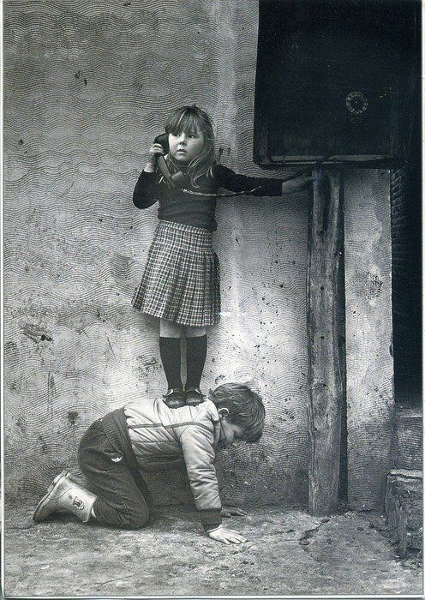
Communication
Talking/Listening
Provide space for this
Empathy
Problem-solving
Celebrating mistakes
Don’t try to fix it
Curious questioning

Slide 11
Boundaries and limit setting
Give space to communication
What is okay and what is not
Communicate feelings (I feel…)
Limit time to discuss difficult feelings

Slide 12
Questions?
Notes:
JS

