Slide 1
Welcome to the Year 6 SATs Evening Thursday 14th March 2019

Slide 2
During this meeting we will cover:
Key dates What are SATs? Grammar, Punctuation and Spelling (GPS) Reading Maths
Writing and Science The Week of SATs Scores and results Supporting your child Questions

Slide 3
What are SATs?
SATs stand for Standardised Assessment Tests
SATs were first introduced in the early 1990s
All children in Year 2 and Year 6 must take the SATs
In Year 6 children are tested on:
Grammar, Punctuation & Spelling
Reading Comprehension
Maths (arithmetic and reasoning)
In Year 6 SATs will be sent away to be marked by
external markers
Year 6 children are also assessed for their writing
although there is no test.

Slide 4
Key Dates
Year 6 SATs week is w/c 13th May 2019 nationally
Date | Activity
Monday 13th May | English Grammar, Punctuation and Spelling papers 1 and 2
Tuesday 14th May | English – Reading Paper
Wednesday 15th May | Maths – Paper 1 (Arithmetic) and Paper 2 (Reasoning 1)
Thursday 16th May | Maths Paper 3 (Reasoning 2)

Slide 5
Grammar Punctuation & Spelling (GPS)
Monday 13th May, the children will sit two papers for GPS:
Paper 1: Grammar and Punctuation (short answer)
Paper 2: Spelling
Paper 1 : Short Answer Paper | Paper Two: Spelling
Time: 45 minutes Marks: 50 marks | Time: Teacher led Marks: 20 marks (20 spellings)
The overall GPS assessment is out of 70 marks

Slide 6
Grammar & Punctuation (short answer paper) Example Questions

Slide 7
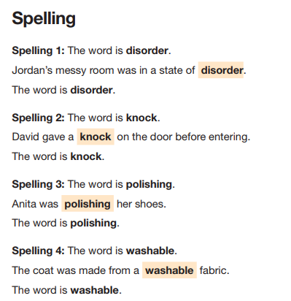
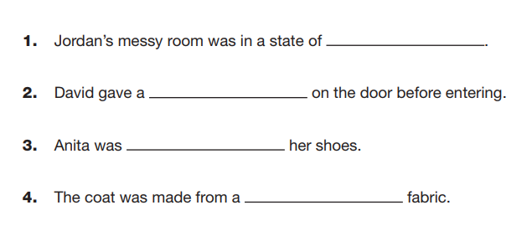
Spelling (teacher-led) Example Questions
The teacher will read out this
And the children will answer on this answer paper
20 spellings in total – a mix of ‘common exception
words’ and spelling rules taught throughout KS2

Slide 8
Reading
Tuesday 14th May, the children will sit one paper for reading to test their reading comprehension.
Reading Paper: Reading Comprehension
Time: One hour Marks: 50 marks
The children will have one hour to read 3-4 texts (a range of genres - usually one non-fiction and perhaps a poem, as well as fiction) and answer related questions. They need to use a variety of skills: retrieval, inference, opinion, vocabulary and wider context.

Slide 9
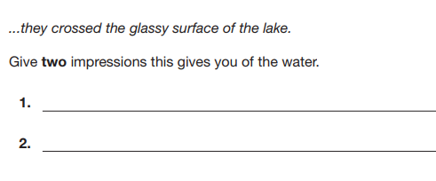
Reading Comprehension Example Questions
Inference
Using a variety of
comprehension skills:
Literal answers (retrieval)
Inference (reading
between the lines)
Opinion questions
Vocabulary questions
Wider context
General knowledge –
linked to text
Vocabulary
Opinion – using evidence from text

Slide 10
Maths
Wednesday 15th May and Thursday 16th May
The children will sit three papers for maths:
Wednesday 15th May – Paper 1 Arithmetic
Wednesday 15th May – Paper 2 Reasoning
Thursday 16th May – Paper 3 Reasoning
Paper 1 Arithmetic | Paper 2 Reasoning | Paper 3 Reasoning
Time: 30 minutes Marks: 40 marks | Time: 40 minutes Marks: 35 marks | Time: 40 minutes Marks: 35 marks
The overall maths assessment is out of 110 marks

Slide 11
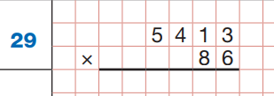
Maths Paper 1 - Arithmetic Example Questions
Straight Calculations including:
Four main operations
Column Addition/Subtraction
Adding/Subtracting Fractions
Multiplying/Dividing Fractions
Fractions of amounts
Percentages
Long division/multiplication
Place value (x/ by 10, 100, 1000)
Missing number problems
Decimals
Squared/cubed numbers

Slide 12
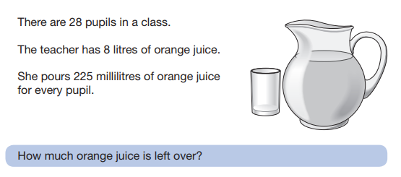
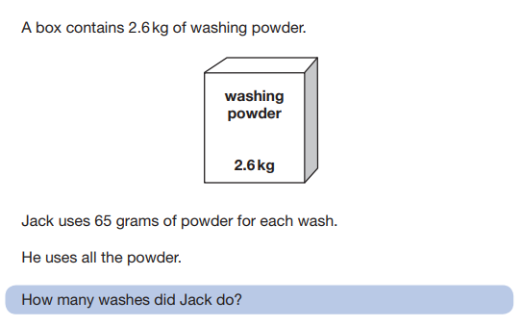
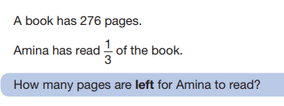
Maths Paper 2 & 3 - Reasoning Example Questions
Choosing which calculations to
use to find out the answer:
Often multi-step problems
Need to read the questions
carefully – what information is
actually required?
Measurement
Time
Shape
Angles
Statistics
Symmetry
Translation/Rotation
Co-ordinates

Slide 13
Writing and Science
There will be no SATs testing for your child in writing or science.
Instead, your child will be assessed over time by the Year 6 teachers as to whether they are working towards, working at or working above expectations in these areas.
To ensure consistency of standards, the school may be selected for external moderation.

Slide 14
The Week of the SATs
It is really important that your child arrives at school on time to be
able to reach their full potential in SATs
All children should be in by 8.45am at the latest Monday
to Thursday of that week (13-16th May)
We aim to create a calm start to the day and will try to keep things
as normal as possible
If your child is ill please contact us as soon as possible so we
and decide on the best course of action

Slide 15
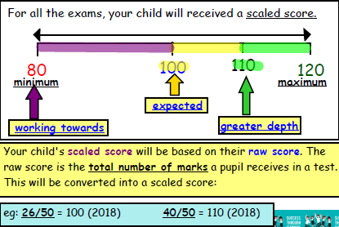
Scores and Results

Slide 16
Scores and Results
SATs are completed for two main reasons:
to support the school’s judgement on how your child is doing
compared to any other child in the class, in Richmond or in the
country.
to find out how the school is doing compared to other schools,
locally and nationally.
It is important to remember that S.A.T.s do not give us information on your child in other areas of the curriculum such as the foundation subjects (Art, PE, Humanities etc.)
They also do not give information on the many personal qualities and attributes of your child - we are always keen to recognise children for achievements outside of SATs as well!

Slide 17
Supporting your child
Please continue to provide the support you have been doing throughout the year:
Maths
Times table practice (e.g. Times Table Rockstars)
Ask questions e.g. conversion (how many g in a kg/hours in a minute), talk about intervals of time (e.g. if we set off now and it takes 49 minutes, what time will we arrive?)
Reading
read their books with them regularly (out loud and ask them questions about the book, discuss new vocabulary)
read other stories to them – discuss inference points, new vocabulary
General knowledge – have discussions about current affairs, history, places in the world
GPS
Encourage them to learn their spellings and practise with them
Help them to remember specific terminology from their English ‘homework books’
e.g. antonyms/synonyms

Slide 18
How else can I support my child at home?
Reinforce a calm and measured approach
Support and encourage your child to complete their homework daily
Help them to stay focused and positive
Encourage resilience and independence
Manage food, sleep and screens!

Slide 19
Q & A

