Slide 1
Managing Anxiety in Children
Tamsin Owen
Clinical Psychologist and Deputy Head of EHS

Slide 2
What we’ll cover . . .
What is anxiety?
How to notice anxiety in your child
What parents can do to help
practical , calming strategies
thought-based strategies
exposure
Resources
Questions - Feedback

Slide 3
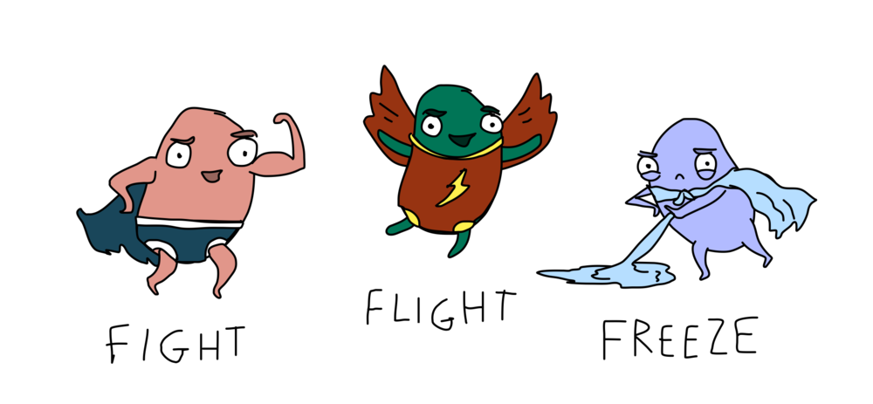
Understanding Anxiety
All humans experience fears at different points in their lives. This is a normal part of development.
Anxiety is an expected, normal and transient response to stress; it maybe a necessary cue for adaptation and coping.
Anxiety can be mild and short lived or pervasive and intense, causing a great deal of distress and placing very real restrictions on life.
A moderate amount of anxiety helps us to do well. Too much or too little anxiety keeps our performance lower.
Anxiety is part of our body’s fight/ flight/ freeze response to danger.
Notes:
We can start by understanding a bit more about anxiety.
Becomes a problem when these responses triggered despite no immediate threat. When a child is unable to regulate their emotions they may have a fight/ flight or freeze response eg. runs away/ hits out/ switches off as coping mechanism.

Slide 4
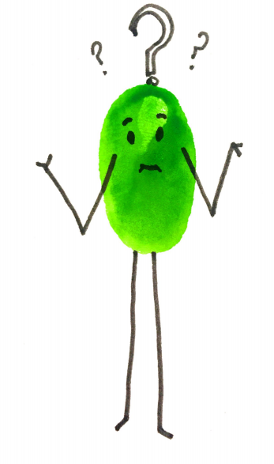
Recognising a Problem
Distress - It becomes a problem when it is irrational, uncontrollable and disruptive
Interference - When it interferes with the child’s life
Avoidance - Often it is the avoidance behaviours that finally bring the problem to our attention
Notes:
As we have discussed, it is normal for children to experience some anxiety during developmental stages.
However, the child can be seen as suffering from an anxiety disorder if the following three factors occur:
- Distress - It becomes a problem when it is irrational, uncontrollable and disruptive
- Interference - When it interferes with the young person’s life
- Avoidance - Often it is the avoidance behaviours that finally bring the problem to our attention
Avoidance – eg. children avoid social situations/ avoiding school/ not participating in usual hobbies eg. Football, dance classes
Often child’s anxiety not only impacts child but also whole family – feel like having to plan around child.

Slide 5
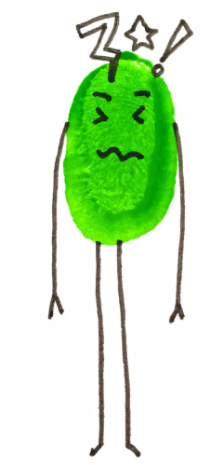
Signs
and
Symptoms
Notes:
EF

Slide 6
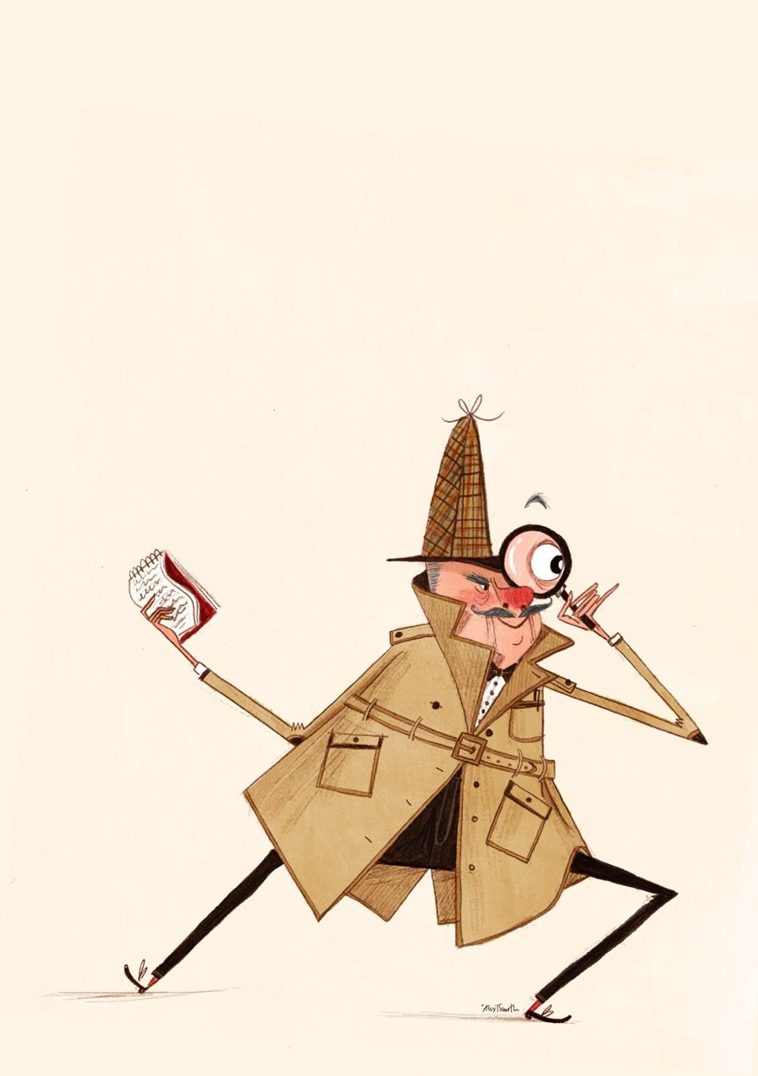
What you may notice…
Thoughts and reenactment:
Talking about their worries
Re-creating “stories, worries” in their play
Mood
Appearing low, sad or more tearful or withdrawn
Behaviour
Being angry, argumentative, getting into fights
Demanding attention/ constant reassurance, “clingy” behaviour
Losing confidence – avoiding doing things like school work, seeing friends
Physical
Changes to sleep & appetite
Physical health complaints e.g. headaches, stomach aches
Notes:
We often view anxiety/ low mood as something that can communicated by a worried/ sad face. But anxiety and low mood can be expressed in many different guises.
Symptoms of anxiety and low mood / depression do overlap. Important to just be aware of changes in behaviour.
Physical health complaints e.g. headaches, stomach aches – often in younger children.

Slide 7
Ways to explore anxiety
Ask, using open-ended question (e.g. what kind of worries do you have at the moment?), but be aware the children may not be aware or want to share.
Be curious - wonder alound with the child/YP - “I wonder whether you’re feeling worried about your spelling test and it’s making you not want to do a,b,c/ affecting how you are with your brother?”
Notice and normalise worry as a way of trying to open up dialogue about it/reduce stigma. Mention if you have a worry and how you are going to deal with it.

Slide 8
Ways to explore anxiety
Externalise anxiety
Come up with a name/character for anxiety (e.g. the wobbles)
This helps the child to see the anxiety as separate to them and this can empower them to “fight against it” or “soothe it” using the strategies disucssed.
It also helps families to work as a team against anxiety (e.g. “ I think the wobbles have come to say hello”)
Externalising resources:
Cheeky Worries by Patrick Davey & Anna Smith
The Unwanted Party Guest - You Tube clip by Russ Harris

Slide 9
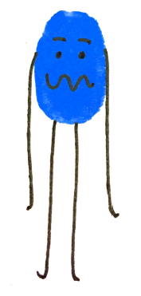
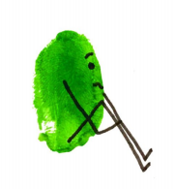
What can parents do to help?

Slide 10
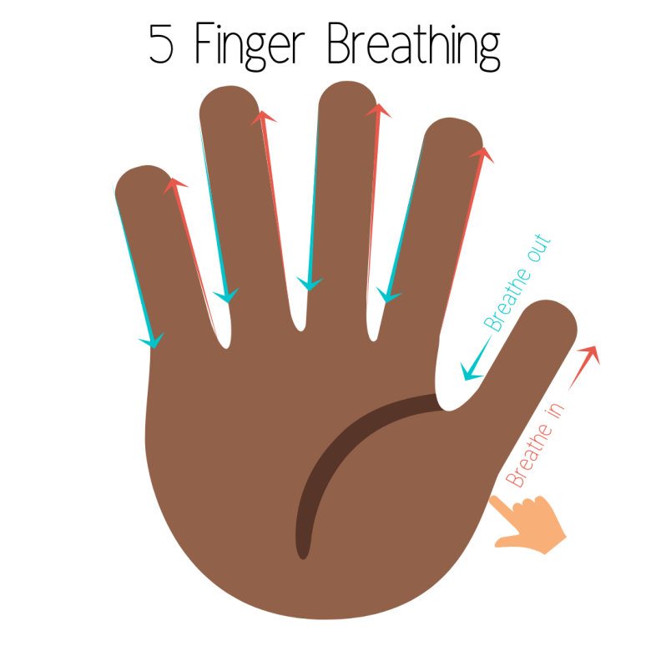
General anxiety management: Practical
These can help with anxiety in the moment but, if practiced regularly can help give a calmer “baseline”
Grounding techniques:
5 senses game (5 things you can hear; see; smell etc)
Body scan (apps to support e.g. Headspace)
Breathing exercises:
5 finger breathing
Breath in for 5 out for 6

Slide 11
General anxiety management: Practical
Physical:
Running around the garden/outside space 5 times
Doing 50 jumping jacks
Yoga/stretching (cosmic kids yoga)
Progressive muscle relaxation

Slide 12
Calm Box: create together
Go and get a drink of water and drink it slowly
Stretch like a cat
Take five deep breaths.
Sort wooden blocks into colours
Colour a pattern in a colouring book
Play with fidget toy for five minutes
Listen to a relaxation audio for 5 minutes
Mould aroma dough in your hands. Smell it. Make something out of it and put it back. Smell your hands to remind yourself what you did
Make a pizza. The key adult draws a circle on the child’s back and uses different touches to represent pizza toppings of the child’s choice
Notes:
Useful in helping to calm child down.
CALM BOX
A small index card box containing an assortment of cards to choose from.
Each card should list an activity that can be used to soothe a child’s heightened anxiety level, with the specific child in mind.
It is useful if each card has both a written and visual cue to describe each activity.
Each activity should take about 5 minutes to complete.
Ensure that the try and incorporate as many of the senses as possible within the chosen activities in the box. Initially the child needs to test which of their senses is the preferred choice to calm themselves.

Slide 13
Thought-based strategies

Slide 14
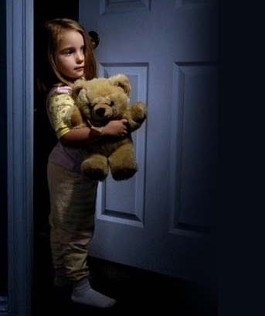
Anxious thoughts & the vicious cycle of anxiety
Fear of the Dark
Thought
“Something’s going to get me”
“I am in danger”
Actions
Always leave light on
Never alone in dark
Feel
Scared
Anxious
Body
Heart rate increases
Trembling
Feel hot and sweaty
Hypervigilant
Associate these actions with feeling safe
Notes:
Because of the way that anxiety impacts our thoughts, our feelings, our physical responses and the way we behave, this can generate an unhelpful cycle.
Here we have an example of a child who is scared of the dark.
In this instance, the thoughts the child has include: “Something’s going to get me” and “I am in danger”, these thoughts then trigger the child to feel scared or anxious, the body then responds by the heart rate increasing, feeling hot and sweaty, trembling. This response can feel unpleasant and therefore leads the child to avoid being alone in the dark and always leaving the light on.
However, this behaviour reinforces a belief that the child cannot cope and feeds more worried thoughts and strengthens the belief that they really are in danger.
On a positive note, because of the multiple areas which drive anxiety, it offers a range of opportunities to break the cycle either through challenging thoughts, relaxing the body so that we send a calm signal to the brain so that it can better access positive and balanced thoughts or gradually changing behaviour so that the child can begin to learn that they can cope and thereby undermining the previously held unhelpful beliefs.

Slide 15
Thinking Errors
People who are stressed can make errors in their thinking:They may either overestimate how likely it is something bad will happen or overestimate how bad consequences of an event will be
People also often underestimate their ability to cope
People are hyper vigilant when they are anxious so they are on the lookout for danger and may misinterpret a situation as dangerous

Slide 16
How to think realistically
Catching thoughts-Identify what the thought behind the emotion is by asking yourself “What is making me feel this way?” “Why am I worried?” and “What do I think will happen?”
Evaluating and challenging- How likely is the thought? Look for evidence for the thought and evaluate it.List some alternative possibilities regarding your worrying thoughts.
Evaluating and challenging- How bad could the situation be? Ask yourself”What is the worst that could happen?” You will probably realise that what you imagine as the worst outcome, isn’t that bad after all

Slide 17
Things parents need to watch out for
Giving too much reassurance: All parents reassure their children and at times it can help to reduce stress. However, reassurance does not tend to help reduce anxiety in the long run. Reassurance can be addictive-the more parents offer it, the more children want it. Children need to be able to feel that they can deal with their fears on their own and test them out for themselves whether or not their worried thoughts are accurate. Instead of reassurance, you can use empathy to validate your child’s feelings.
Providing children with all the answers: Instead of answering question, ask them. It helps children to think for themselves and helps them to remember the conclusions drawn as they have worked them out themselves. This also puts children in control.

Slide 18
Detective Thinking
The detective thinking process or “putting your thoughts on trial” is a process that has been altered for children to understand.
The child takes on the role of a detective who must investigate the evidence for a thought and come to a conclusion about what a detective might think instead
This is a 5 step process

Slide 19
Step 1: Identify the event that is causing concern
Ask Yourself
What is happening?
What event am I thinking about?

Slide 20
Step 2: Identify the thought behind the feeling
Ask yourself
What exactly am I worried about?
What is it about the situation that is concerning for me?
What do I think will happen?
How worried am I based on this thought?
Notes:
E.g. The situation is that I have to give a presentation at school. My thoughts are that I keep worrying that people will notice how embarrassed I am, and talk about me behind my back.

Slide 21
Step 3:Look for realistic evidence
Ask yourself
Really, how likely is this?
How many times have I faced this situation and how many time has it happened?
Have I ever seen it happen to somebody else before?
How much does it happen to people generally?
Notes:
E.g Well I've given talks before and once I got really embarrassed. Now I come to think of it, I've probably given 10 talks this year and I only got embarrassed once. I guess I have seen some other kids get embarrassed a couple of times, so I'm not the only one who feels like this. Sometimes I've heard other people say that they gave really bad talks or felt really embarrassed about doing the talk, but I didn't notice that they did anything wrong, or looked embarrassed. Even when I did notice that other kids were embarrassed, I really didn't bother to talk about it much and I didn't hold it against them.

Slide 22
Step 4: List the Alternatives
Brainstorm and try to think of as many alternative outcomes to the feared situation as possible. Ask yourself
What else could happen?
What would I think if it happened to someone else?
Notes:
E.g I might feel embarrassed, but people won't necessarily notice. Most people look a bit nervous or embarrassed when they are speaking in front of a crowd - so I won't look different to most people. Even if people DO notice that I look uncomfortable, that doesn't mean that they'll talk about me in a horrible way. I've given talks before and been embarrassed - but no-one said anything much about it. I've seen other people give talks and look really embarrassed, but people actually said kind things to them.

Slide 23
Step 5: Identify a realistic thought
Based on the evidence that has been found about the worried thought, ask yourself
What is a realistic thought that I could think in this situation?
How worried would I be in this situation if I thought this thought?

Slide 24
Coping thoughts
I’m safe
I can do this!
I’ve done it before, I can do it again!

Slide 25
Exposure

Slide 26
Exposure
Exposure is a key technique which is based on the idea that you have to face fear to fight fear
The key principles of exposure are:
Fears are faced gradually, from lesser fears to greater fears-a hierarchy fears is drawn up to work through each fear
The child must stay in the situation for long enough-It is best if the young person can stay in the situation until they are no longer scared
Repetition is critical-The child must go into their feared situations (or similar) over and over. Simply doing it once will not remove fear
Progress will not be smooth-Even though the theory is easy, progress is often up and down
Beware of subtle avoidance and distraction-To properly overcome fear, your child must fully experience the feared situation, and not be distracted from it.
Consistence of rewards is important-Rewards should be given as soon as possible after your child has successfully completed one of the items on their list.

Slide 27
How to make a step by step plan
Step 1-For each theme of the fears and worries list, come up with a practical goal (e.g. stroke a dog)
Step 2-Brainstorm all the possible steps which could be used to help reach this goal.
Steps can be made up of two different things:
a) Different tasks involving the same theme, or
b) Variations of the same task. You can vary a step according to the:
○ Location (Close/Familiar or New Area/Unfamiliar)
○ Time Spent in Situation
Type of exposure (e.g. photo, real life)

Slide 28
How to make a step by step plan
Step 3-Rate each of the possible steps according to the worry rating that they generate when they think of doing the step.
Step 4 - Create a ladder of steps by putting the worry ratings in order and writing them on a stepladder form
Step 5 -Negotiate rewards that will be allocated to each step of the ladder, and an ultimate reward for achieving the goal.
Notes:
Example of step ladder:
Goal: To be able to play at a friend’s house without worrying about being away from Mum.
At her friend’s house with Mum, Mum leaves for 10 minutes
Playing at friend’s, Mum leaves for 30 minutes
Playing at friend’s for one hour, say goodbye to Mum at the door
Playing at friend’s, Mum will collect her ‘in about 2 hours’
Playing with a different friend for the afternoon – Mum not there
Going to another friend’s birthday party
Eating dinner with her friend’s family

Slide 29
Exposure to Consequences
Many children with anxiety over estimate how bad the consequences of a situation will be
They may avoid the risk of having a catastrophe happen
This is common for children who worry about a lot of things or have social fears
Children may also benefit from exposure to consequences if they try to avoid making mistakes-an example being that some children don’t complete tests to avoid making mistakes
It is important to incorporate detective thinking when using exposure to consequences about the implication about what happens to ensure worry reduces through the steps

Slide 30
Example of Exposure Prevention Stepladder
Goal: Not to be bothered by making mistakes at school
1. Listening to music for 1/2 hour before doing homework after school
2. Crossing out a mistake in homework and handing in the work anyway
3. Not bringing a permission note back to school on the very first day it is due
4. Making a deliberate mistake in a maths exercise
5. Ruling a wobbly line on a page and leaving it there
6. Handing in an essay with two spelling mistakes
7. Answering a question in class when you are not 100% sure of the answer
8. Forgetting to take library books to school on Library day
9. Deliberately giving the wrong answer to a question
10.Not having the correct text book for a lesson

Slide 31
Exposure at School
Many children’s fears are worse when they are at school, particularly social anxieties
Stepladders at school need to be simple so that the child is able to do it alone
You may need to do some research to find out how steps can be implemented at school to ensure your child can complete steps

Slide 32
Increasing motivation to use strategies
Different things will work for different children
Incorporate into learning?
Reward
Do as a family
Be realistic - learning anxiety management can be a lifetime’s work. Start to sew the seeds and this can be enough.

Slide 33
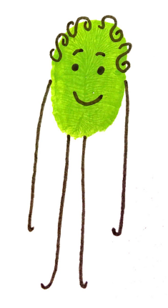
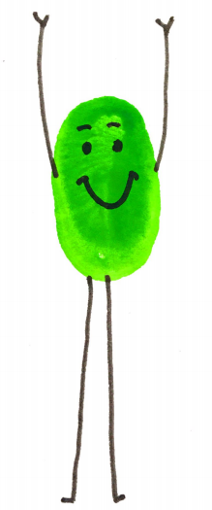
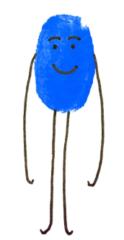
We are all unique.
Every child is unique.
You know your child best and what may work for them.
Notes:
It is important to remember that we are all unique.
Every child is unique.
You know your child best and what may work for them and it may take time to trial different approaches and establish the best way you and your child can work together to manage their worries.
What strategies have you tried
How long for?
What worked so far?
Why did it work?
What did not work so far?
Why did it not work?

Slide 34
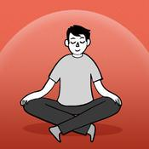
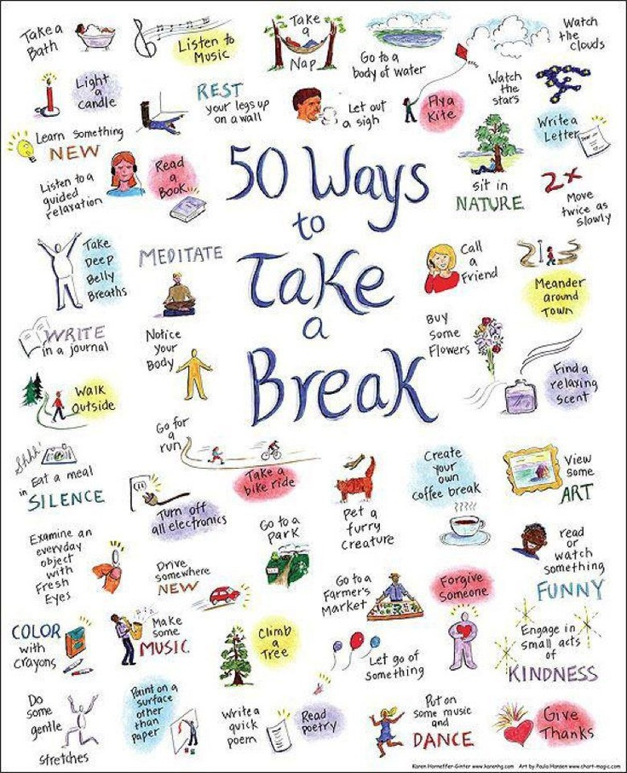
Stop, Breathe, Think
Calm
Think Ninja
Headspace
Notes:
HEADSPACE
Offers 10 free mindfulness exercises with audio and excellent graphics. Advanced exercises require subscription fee. Sessions fit into everyday life, and app offers reminders and a personal progress page. Recommend for anyone experiencing mild to moderate stress, anxiety or low mood.
STOP, BREATHE, THINK
A straight forward app that provides short mindfulness and meditation exercises with good graphics. User can choose different audios depending on mood, and rate mood before and after. Recommend for anyone experiencing mild to moderate stress, anxiety or low mood.
CALM
A user-friendly app that provides guided audio meditation, relaxation and mindfulness tracks & exercises. App opens with view of sea and sound of waves. Suitable for people experiencing stress or mild anxiety or low mood.

Slide 35
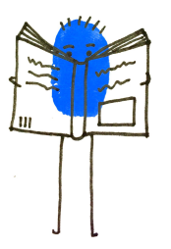
Resources
What To Do When You Worry Too Much by Dawn Huebner
The Huge Bag of Worries by Virginia Ironside
Overcoming Your Child's Fears and Worries: A Self-help Guide by Cathy Cresswell
“Relax Kids” Their website provides useful resources to help children cope with a range of stressful situations: http://www.relaxkids.co.uk/UK/Home
www.kr.afc.info.org.uk/EHSResourceHub

Slide 36
Referrals to other services
Referral to Emotional Health Service via Achieving for Children Single Ponit of Access

Slide 37
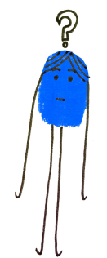
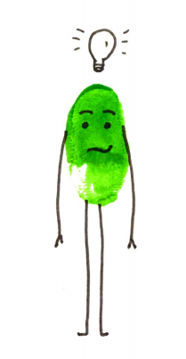
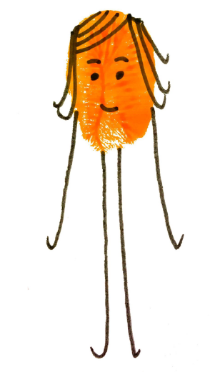
Questions?

